Slide 1
Usability Engineering UCD, Personas
Prof. Dr. Christian Reimann

Slide 2
Process

Slide 3
Definition „Usability“
Usability is defined by the
Effectiveness,
Efficiency and
Joy
with which users can achieve a goal, or accomplish a task.
How to ensure good usability?
In a structured process, so it is
Reliable,
Repeatable,
Etc.
But not plain luck ;-)
User Centered Design Process (ISO 9241-210)
generally accepted process (at least as basis) for sw-development

Slide 4
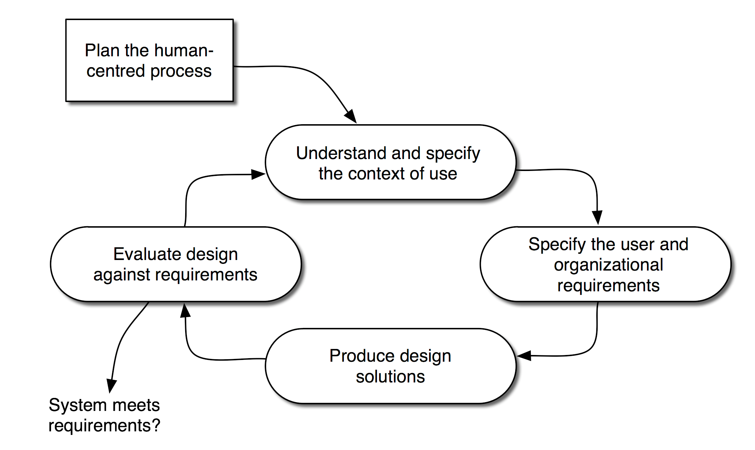
User Centered Design Process DIN EN ISO 9241-210

Slide 5
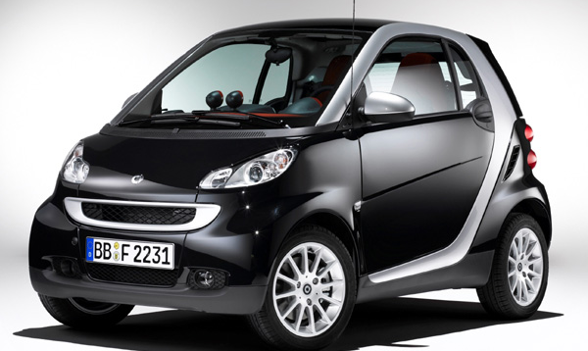
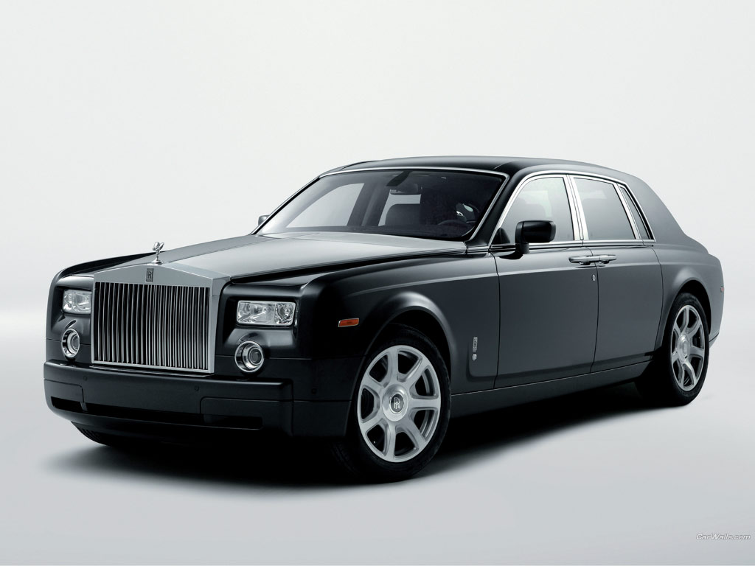
Which car is better?

Slide 6

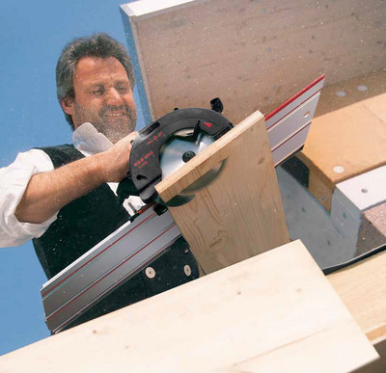
Context matters!!

Slide 7
User Centered Design Process

Slide 8
Personas

Slide 9
Personas (Alan Cooper, 1998)
Supports projectmembers:
To put themselves into users position, based upon empathy.
A Persona is a fictional person
It combines and represents characteristics of specific typical users
A Persona should be short, but descriptive
Not more than one piece of paper (might be a big piece)
As visual as possible, use pictures, fotos, etc
Usually created during a workshop
Maintenance required (might change during project) => name responsible person
Create as many Personas, as you need, usually one or two per target group

Slide 10
Usage of Personas
Processes, data, resposibilities, etc. can be attached to a Persona
„How would Mr. Miller react in this situation?“
„Does Mrs. Beckett have all the required information at this point to fill out the form?“
This helps to create a bridge between marketing and development!
The Persona as a virtual user/customer can always be „present“ in a project.

Slide 11
Benefits of using Personas
Dangers?
Common ground for all stakeholders (developers, designers, marketing, management, ...)
Personalisation supports discussion and communication between all stakeholders!
Very little effort needed => low costs
Find, describe, communicate, maintain

